Slide 1
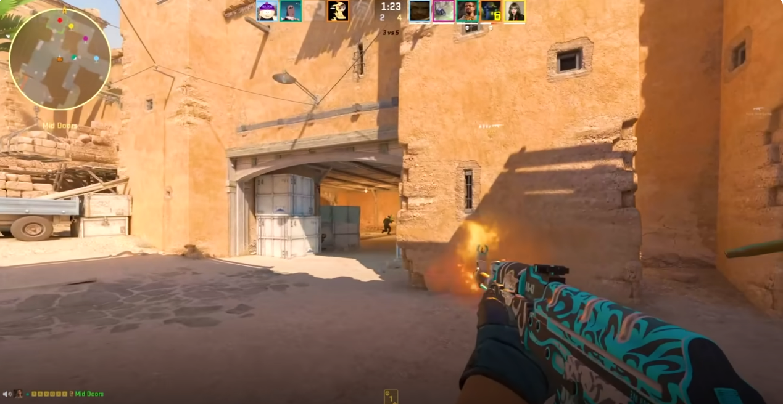
Cognitively stimulating leisure activities
Engagement in leisure activities contributes to a healthy lifestyle, but those with greater cognitive challenge show more potential for inducing cognitive improvements (von Bastian, Hyde & Jiang, 2023)
Notes:
Engagement in leisure activities is thought to contribute to a healthy lifestyle; however, not all activities are made equal, and those which involve a greater cognitive challenge show greater potential for improving cognition.
Video games are a highly popular and challenging leisure activity:
Screenshot from the video game we research, Counter-Strike which is a FPS game: typically featuring dynamic and complex environments which require players to make fast decisions or suffer in-game consequences.
Is there the potential for video games to benefit cognition?

Slide 2
Background
Bediou et al. (2018) found large effects for Action Video Game play on perception (processing speed), spatial cognition, top-down attention, and a medium effect for multitasking.
Bediou et al. (2023) replication finding the same as above, now a large main effect on multitasking.
Sala et al. (2018) found weak correlations between video game play and cognition.
Notes:
As I said earlier Bediou found robust effects of action video game play on cognition, specifically processing speed…
And a replication with improved methodology found the same except that the effect size for multitasking was now larger
Processing Speed and Multitasking is assumed to be important for FPS players who have to quickly process and accurately respond to multiple sources of visual information, switching between targets and other gameplay elements such as the mini-map, in-game chat and weapon-inventory.
Some inconsistent findings so far, which I have some possible explanations for which we wanted to address in our study.

Slide 3
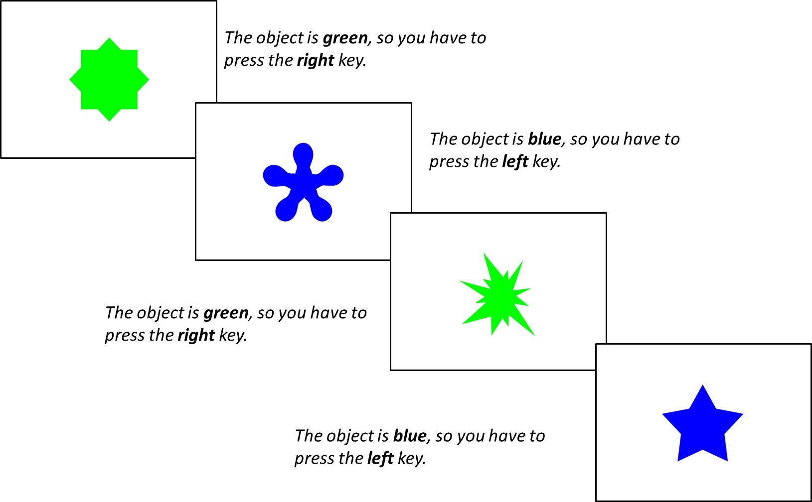
Method
Three Blocks:
Single-rule 1: 64 trials of shape followed by 64 trials of colour
Mixed-rule: 129 trials switching between shape and colour rule
Single-rule 2: 64 trials of colour followed by 64 trials of shape
n = 385
Within the Mixed-Rule Block:
Repetition trials: two successive trials in which the same rule is applied (shape + shape)
Switch trials: rule changed from the preceding trial to the current trial (shape + colour)
Choice Reaction Time Task
Notes:
Online study where participants completed a Choice RT task

Slide 4
Method
Trial Types
Single trials
Repetition trials
Switch trials
Measures
RTs
Accuracy Score
Mixing Costs: RT performance cost of mixing two tasks (repetition trial RTs – single trial RTs)
Switching Costs: RT performance cost of switching from one task to another (switch trial RTs – repetition trial RTs)
Choice Reaction Time Task
Notes:
Online study where participants completed a Choice RT task

Slide 5

Method
Choice Reaction Time Task
Pro
Expert
Casual
CS Questionnaire
Total hours of playtime
Weekly hours of playtime
Current Ranking in CS
Self-rated expertise
Notes:
Following this, they completed a Questionnaire regarding CS expertise and skill which was informed by CS players who we interviewed ahead of this study

Slide 6
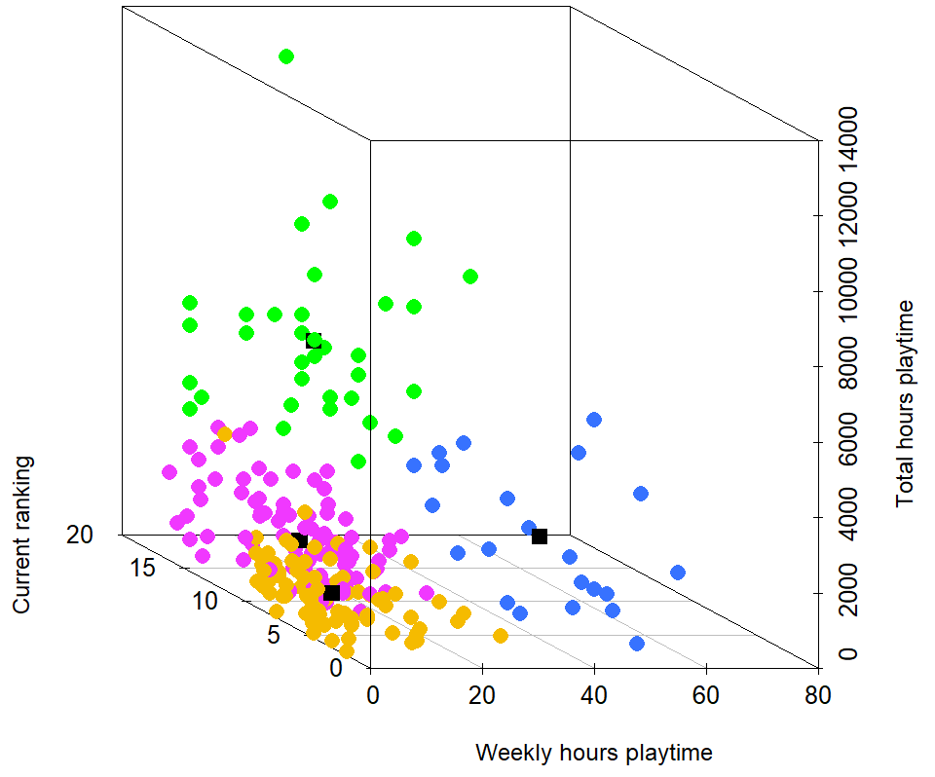
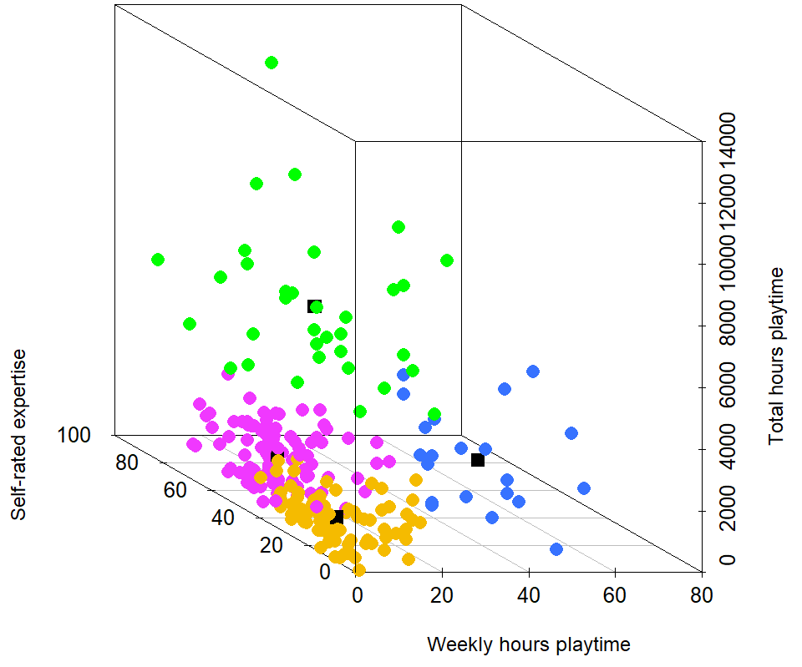
CS Expertise
N = 235
4 CS Expertise Measures
K-means cluster analysis
Semi/Professional N = 34
Aspiring N = 22
Experienced N = 101
Casual N = 78
scatterplot3d function from the scatterplot3d package in R
Notes:
305 people completed this study, and after pre-processing and accuracy filtering, we had a sample of 235, which was fantastic.
The first thing we wanted to explore was our sample’s expertise; to do this, we put our four expertise variables into a k-means cluster analysis.
An unsupervised machine learning algorithm which groups observations into k-cluster groups with minimum within-cluster variation.
Analysis suggested that 4 Cluster Groups would best fit our data: Semi/Pro, Aspiring, Experienced and Casual players.
3d scatter plot with our variables on the following axis:
weekly hours on the x
total hours on the y
current ranking on the z in the left plot and self-rated expertise on the z in the right plot
Displays the range of expertise in our participants, suggests that CS expertise is non-linear and can be measured with a multitude of measures.
Clustering gives us an amazing overview of the expertise of our sample – in greater depth than would have been possible with one measure of video game expertise.
So how did our expertise groups do on the task?

Slide 7
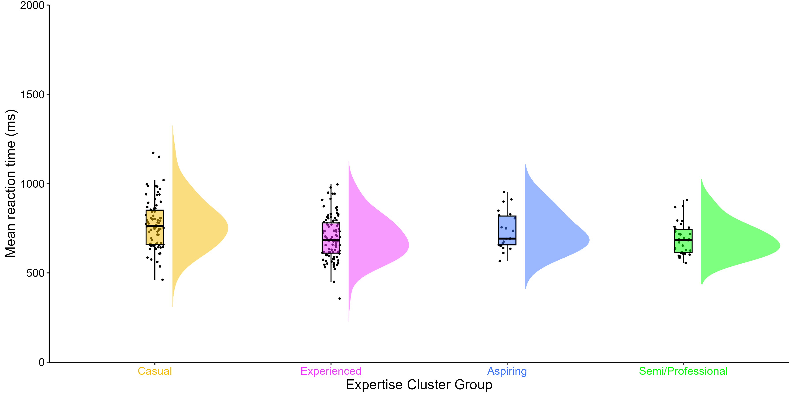
Processing Speed
No differences in accuracy scores, but decisive evidence in favour of a main effect of expertise group on mean RTs: p <.001, BF = 227.63
M = 774.31 ms
M = 733.84 ms
M = 696.61 ms
M = 688.35 ms
raincloudplots and PupillometryR packages in R
M = 591, SD = 112
Notes:
Raincloud plot:
X axis = Mean RTs
Y axis = expertise groups
Dots = participant
Box plot = summarises data from each group in terms of the maximum, minimum, interquartile range and median
Cloud = distribution
Main effect between causal and experienced players – a difference of 70 ms
Main effect between casual and professional players – a difference of 86 ms
Suggests that greater CS expertise is associated with faster processing speed performance with no sacrifices in accuracy.
But how did our expertise groups differ across the different trial types?

Slide 8
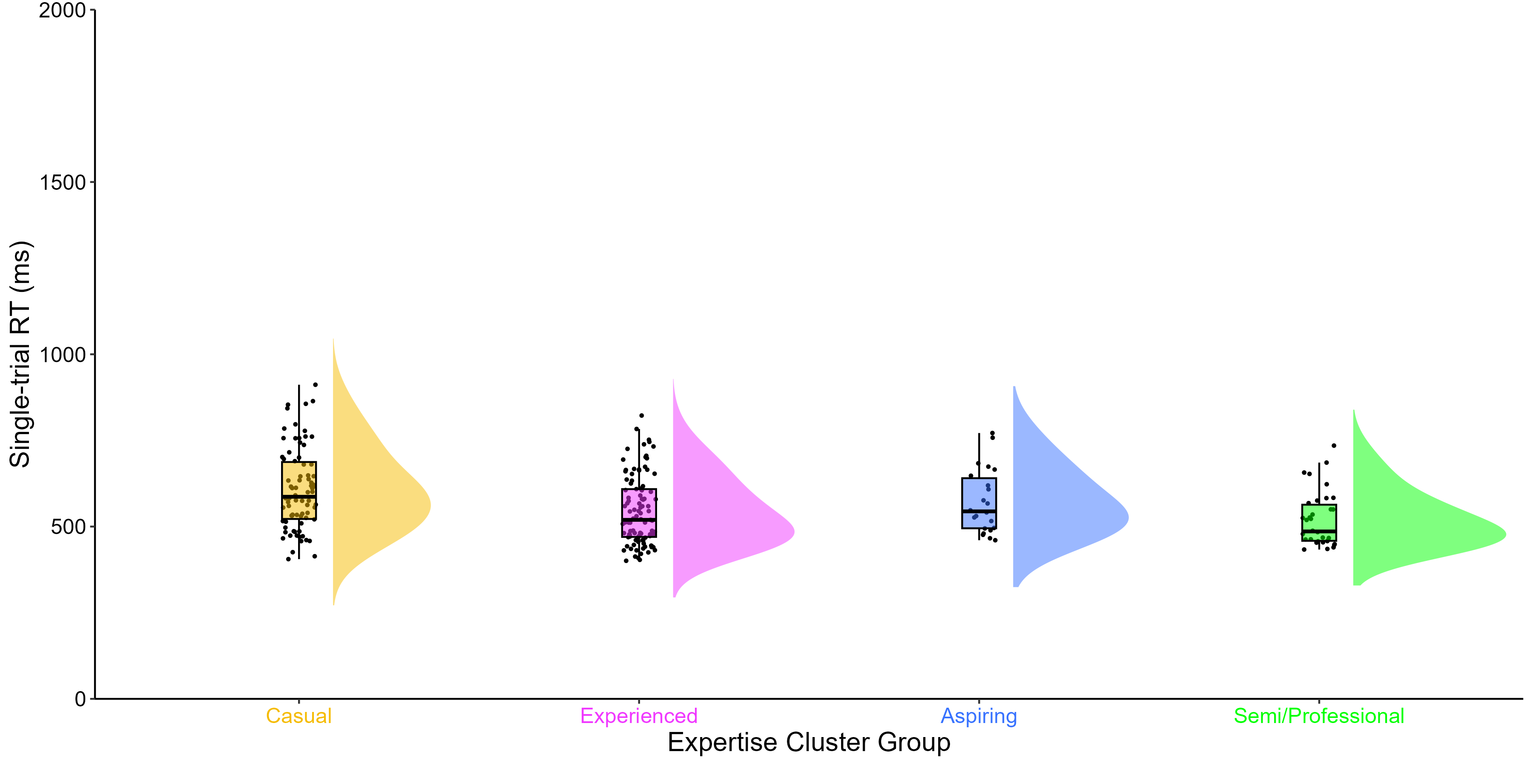
RTs across trial types
No differences in repetition trial RTs. But decisive evidence in favour of a main effect of expertise group on single trial RTs: p <.001, BF = 508.10, and switch trial RTs: p <.002, BF = 16.92
M = 607.64 ms
M = 572.44 ms
M = 544.76 ms
M = 519.12 ms
M = 591, SD = 112
Notes:
Let's look at the single trial RTs across our players
Main effect between causal and experienced players – a difference of 60 ms
Main effect between casual and professional players – a difference of 89 ms
Suggests that on single trials, greater CS expertise is associated with faster processing speed

Slide 9
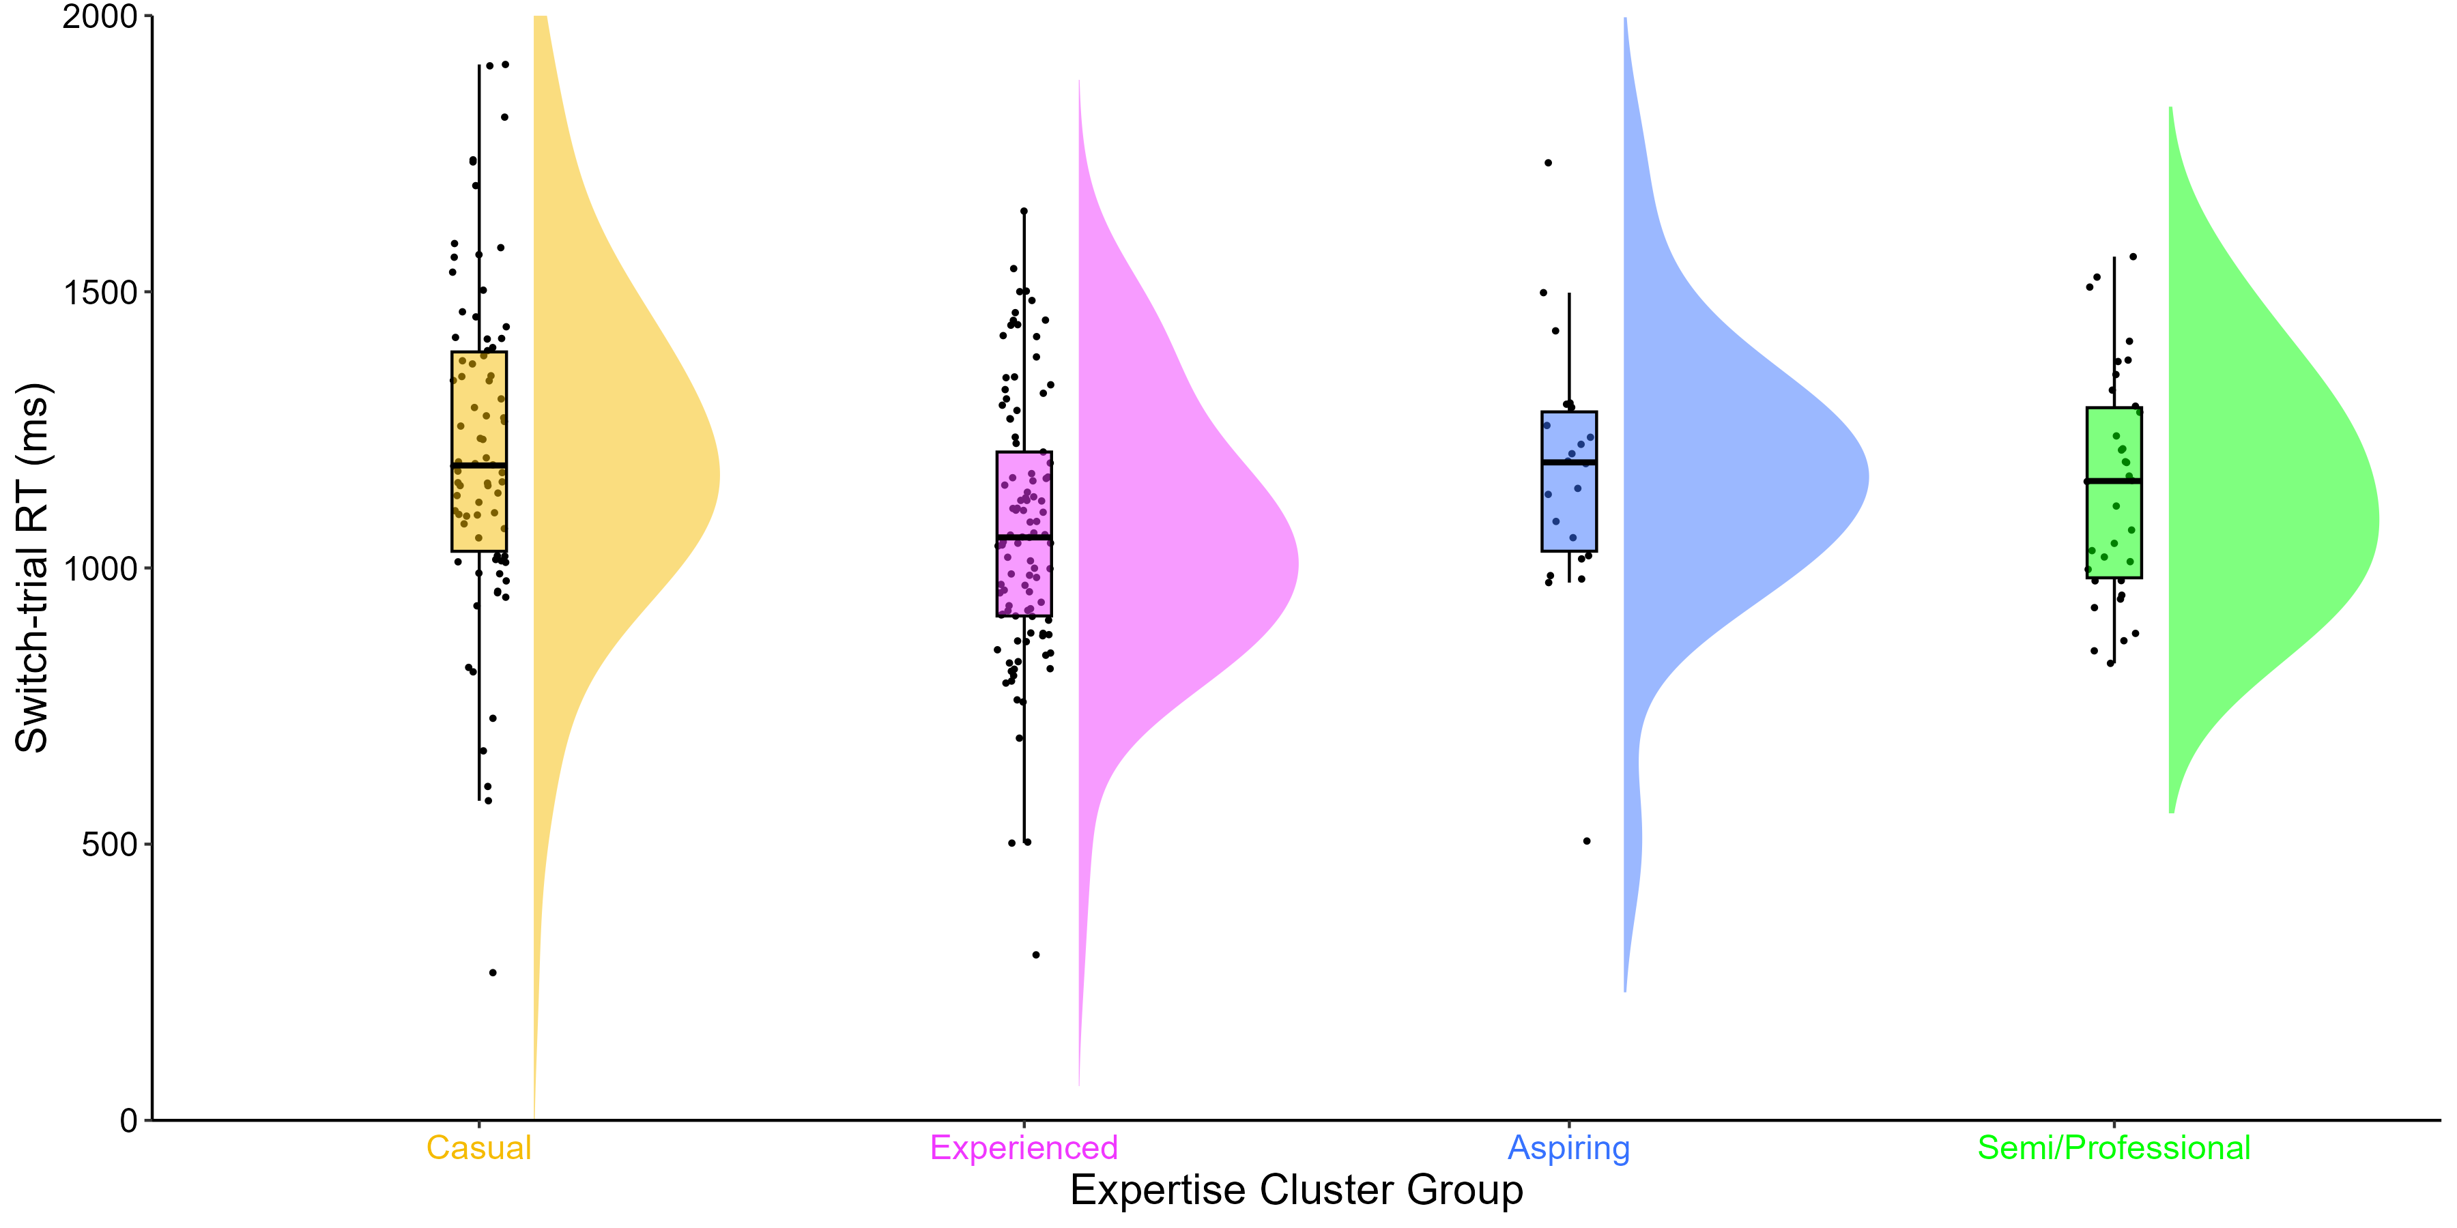
RTs across trial types
No differences in repetition trial RTs. But decisive evidence in favour of a main effect of expertise group on single trial RTs: p <.001, BF = 508.10, and switch trial RTs: p <.002, BF = 16.92
M = 1213.20 ms
M = 1170.66 ms
M = 1067.60 ms
M = 1147.87 ms
M = 591, SD = 112
Notes:
For switch trials the Bayes Factor is much smaller than it is for single trials, just one group main effect:
Main effect between causal and experienced players – a difference of 145 ms
And the distributions are much wider for switch trials.
Notice: Experienced players have the fastest RTs whilst our casual, aspiring and semi/professionals are much slower
This of course, will have ramifications on mixing and switching costs.

Slide 10
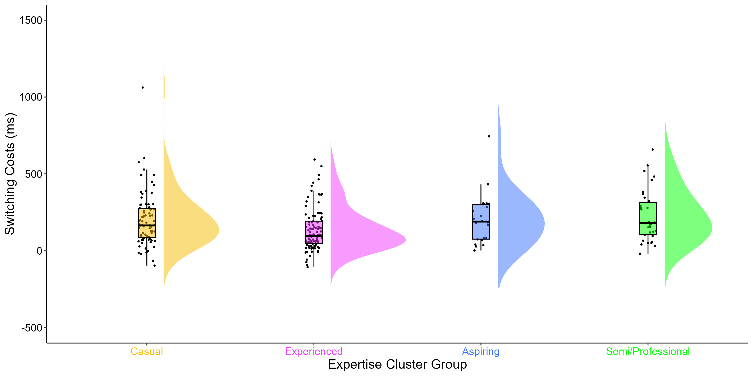
Multitasking Costs
No differences in mixing costs. But substantial evidence in favour of a main effect of expertise group on switching costs: p <.006, BF = 6.56
M = 200.19 ms
M = 205.77 ms
M = 135.64 ms
M = 227.72 ms
M = 591, SD = 112
Notes:
Mixing Costs: RT performance cost of mixing two tasks (repetition trial RTs – single trial RTs)
Switching Costs: RT performance cost of switching from one task to another (switch trial RTs – repetition trial RTs)
Mixing costs were similar across groups, but switching costs were quite different.
Main effect between experienced and causal players – a difference of 65 ms
Main effect between experienced and professional players – a difference of 92 ms
Switching costs were lowest (best) in experienced players and highest (worse) in semi/professional players.
Suggests that less expert CS players have greater switching ability compared to more expert players – opposite of what we would have expected.
What does that mean? … we’ll come back to that.

Slide 11
Drift-diffusion model (DDM)
1. Drift Rate (v)
information accumulation
2. Boundary Separation (a)
response caution
3. Non-decision time (t0)
other non-decisional processes
Green
Drift Rate (v)
Boundary Separation (a)
Blue
Stimuli Encoding
Decision Time
Response Execution
Non-decision time (t0)
Notes:
DDM parameters correspond to latent cognitive processes:
After the initial encoding of stimuli, for example, a shape that could be blue or green, there is a noisy period of evidence accumulation until the information is sufficiently clear.
The slope of information accumulation, known as drift rate (v), represents how efficiently stimuli information is processed. Once a decisional threshold is reached (i.e., if the shape is blue or green) then a response is executed.
The distance between the two choices reflects response caution, known as boundary separation (a) and indicates a possible speed-accuracy-trade-off. If the individual favours speed, their narrow boundary separation indicates low response caution whereas if they favour accuracy, their wide boundary reparation would indicate high response caution. A response is executed once a decision has been made (pressing a key).
The final component, non-decision time (t0) represents the time period of other processes which are not related to the decision itself such as stimuli encoding and response execution
The model provides additional insight into the underlying cognitive processes within a Choice RT Task, beyond that of RT and Accuracy Scores.

Slide 12
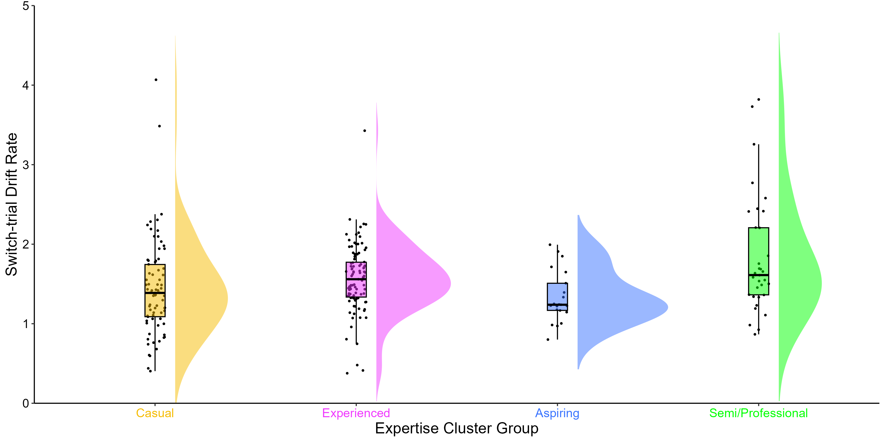
Drift rates (v) across trial types
No differences in single trial or repetition trial drift rates. But, substantial evidence in favour of a main effect of expertise group on switch drift rates: p =.006, BF = 3.67
M = 1.44
M = 1.58
M = 1.35
M = 1.83
(v)
M = 591, SD = 112
Notes:
For switch trials, our semi/professional players had the highest (best) drift rates.
Main effect between aspiring and professional players – a difference of 0.50
Suggests that more expert CS players have greater information accumulation on the more challenging switch trials, despire their greater switch costs we saw earlier.
However, the data here is pretty noisy – distributions and flat and wide and we only have evidence in switch trials so not decisive evidence here.

Slide 13
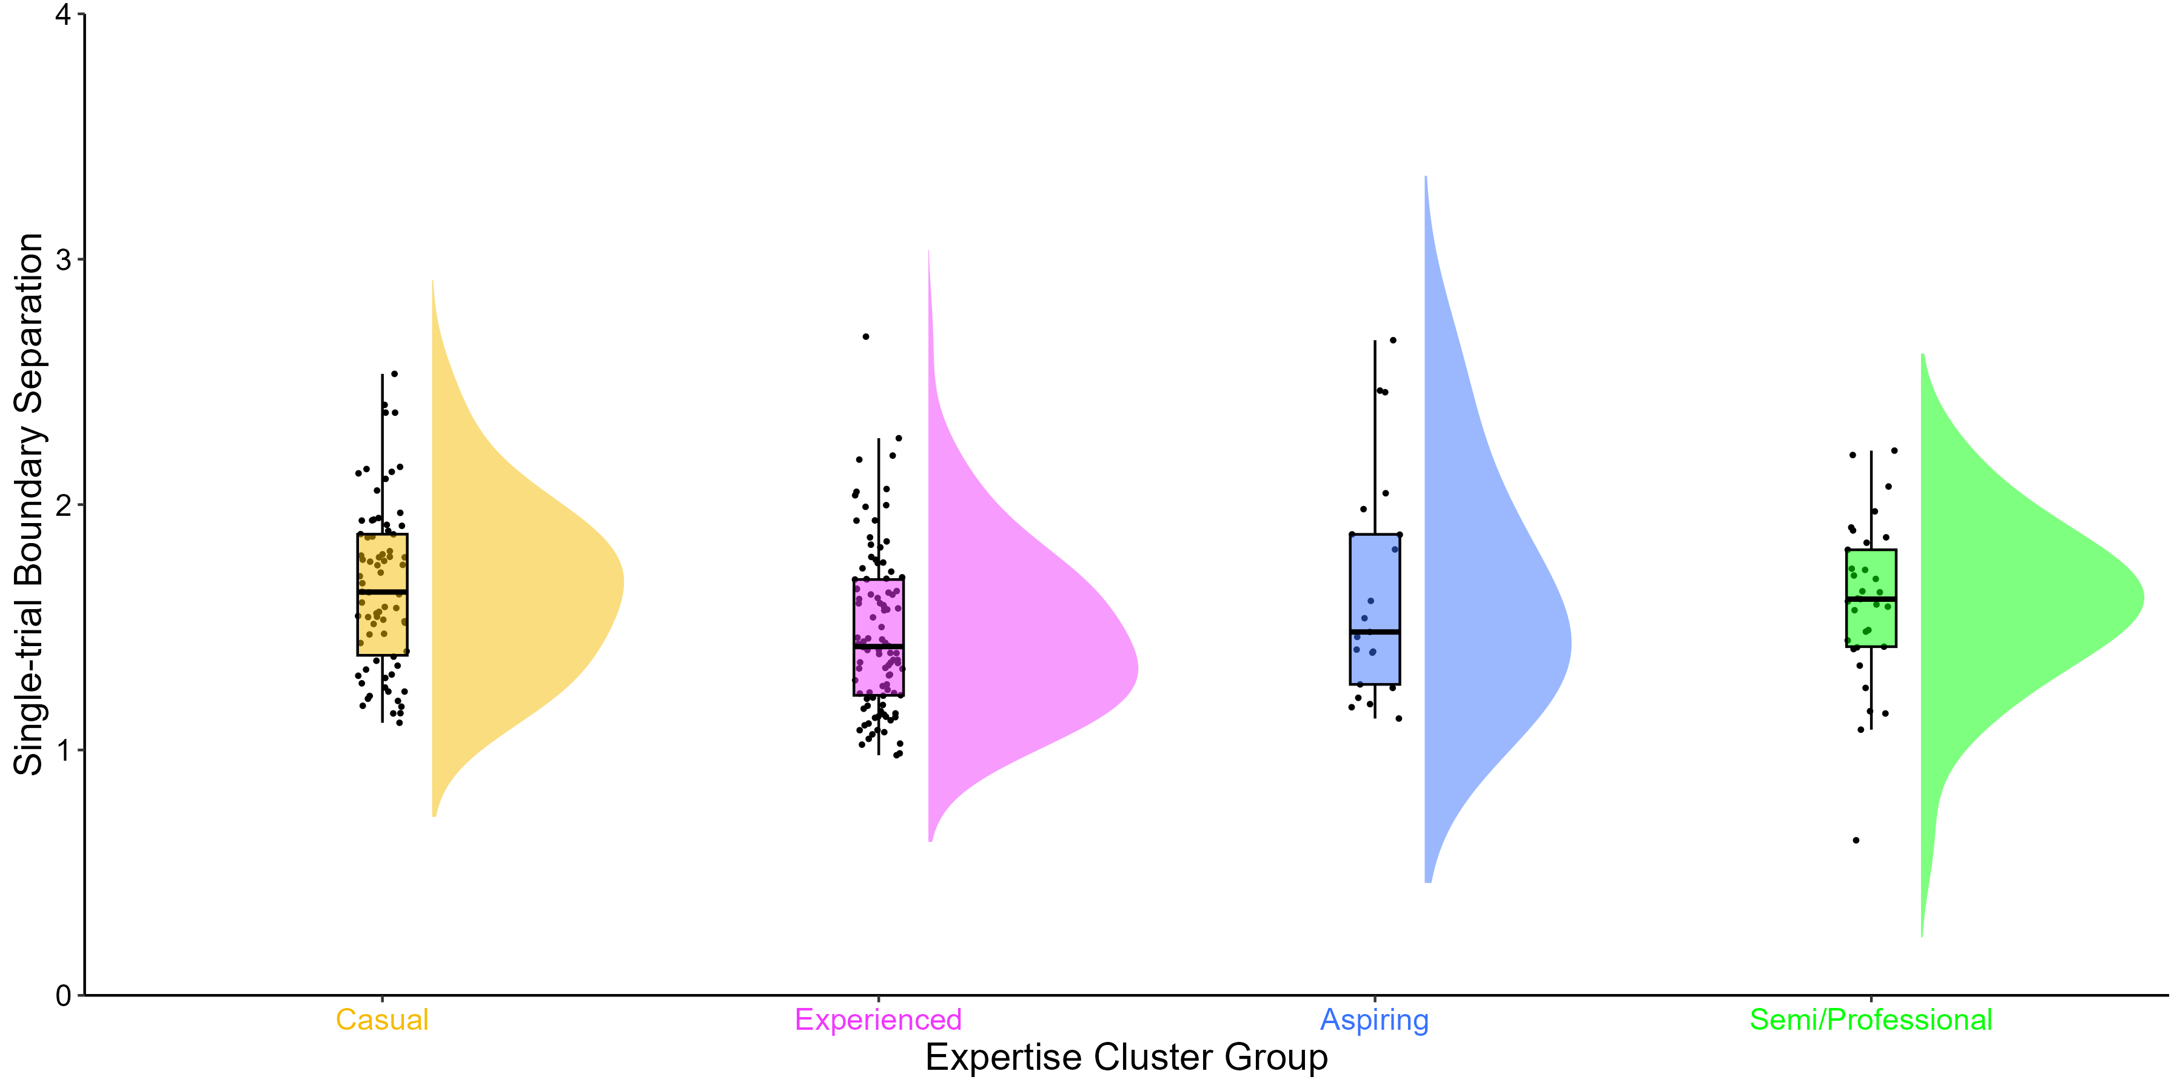
Boundary Separations (a) across trial types
No differences in repetition trial or switch trial boundary separations. But, substantial evidence in favour of a main effect of expertise group on single trial boundary separations: p =.011, BF = 3.73
M = 1.75
M = 1.48
M = 1.65
M = 1.80
(a)
M = 591, SD = 112
Notes:
For single trials, our semi/professional players had the higher boundary separations, pretty close to casual players.
Main effect between experienced and casual players – a difference of 0.27
Suggests that more expert CS players show greater boundary separations on single trials, meaning they exhibit greater caution in their decision, suggesting that they prefer to gather more information before committing to their choice.
Again, the data here is pretty noisy—the distributions are flat and wide, and we only have evidence in single trials, so there is not decisive evidence here.

Slide 14
Non-decision times (t0) across trial types
No differences in repetition trial and switch trial non-decision times. But, decisive evidence in favour of a main effect of expertise group on single trial non-decision times: p <.001, BF = 279.59
M = 0.29
M = 0.28
M = 0.25
M = 0.23
(t0)
M = 591, SD = 112
Notes:
For single trials, our semi/professional players had the shortest (best) non-decision times.
Main effect between casual and professional players – a difference of 0.06
Main effect between experienced and professional players – a difference of 0.05
Suggests that more expert CS players have greater encoding and response execution on single trials, meaning that they process and respond to sensory information faster and more efficiently. This is evident in their fast RTs on single trials.
Contrary to drift rates and boundary separations, the distributions are pretty normal here and we have decisive Bayesian evidence.
Perhaps they key process responsible for faster RTs in more expert CS players is the advantages in non-decision time.

Slide 15
Conclusions
1. CS expertise is a multi-dimensional construct that can be measured by a range of variables and k-means clustering.
Notes:
K-means clustering is one method
But, it remains to be seen if we find the same expertise groups in other samples. We have plans to test that this year.
These four measures may not be applicable to other FPS games or video games from other genres. We’re working with collaborators to generate a similar questionnaire and variables for other games presently.

Slide 16
Conclusions
1. CS expertise is a multi-dimensional construct that can be measured by a range of variables and k-means clustering.
2. Highly expert Semi/Professional players have advantages in processing speed performance, with no sacrifices in accuracy.
3. Experienced players have better switching performance, but there were no differences in mixing performance.
4. Limited evidence for differences in drift rates and boundary separations, but Semi/Professional players have faster non-decision times.
Notes:
Finally, for the drift parameters, we found …
Key component in FPS players fast decision making is fast encoding and motor response
This might indicate greater cognitive efficiency – players can process information and generate a motor response with minimal delay or inefficiency.
Capacity-efficiency model, which Claudia has done work on, in the context of video game training would be facintating to investigate here.

Slide 17
Participants (N = 235)
 | Full Sample |  | Casual |  | Experienced |  | Aspiring |  | Semi/Professional
 | M | SD | M | SD | M | SD | M | SD | M | SD
Gender Male/Female/Non-Binary/Prefer not to say | 211/21/1/2 |  | 71/6/1/0/1 |  | 84/15/1/1 |  | 22/0/0/0 |  | 34/0/0/0
Age | 21.93 | 4.69 | 21.27 | 4.79 | 23.77 | 4.64 | 18.05 | 2.64 | 20.38 | 3.02
Total hours of playtime | 1565.16 | 1926.80 | 624.17 | 534.54 | 1010.11 | 862.32 | 1469.11 | 970.88 | 5434.88 | 2082.08
Weekly hours of playtime | 20.34 | 15.85 | 10.26 | 7.55 | 17.05 | 7.98 | 55.55 | 12.11 | 30.41 | 12.54
Self-rated expertise | 50.68 | 23.48 | 26.12 | 12.30 | 62.96 | 15.33 | 48.95 | 17.59 | 71.65 | 17.50
Current Ranking | 12.04 | 4.68 | 7.74 | 2.86 | 13.39 | 2.98 | 11.41 | 5.11 | 18.29 | 1.77

Slide 18
 | Full Sample |  | Casual |  | Experienced |  | Aspiring |  | Semi/Professional
 | M | SD | M | SD | M | SD | M | SD | M | SD
Score
Mean | 0.94 | 0.04 | 0.94 | 0.04 | 0.94 | 0.04 | 0.93 | 0.05 | 0.95 | 0.04
Single-trials | 0.94 | 0.04 | 0.95 | 0.04 | 0.94 | 0.04 | 0.93 | 0.06 | 0.95 | 0.06
Repetition-trials | 0.95 | 0.07 | 0.94 | 0.08 | 0.95 | 0.08 | 0.95 | 0.05 | 0.96 | 0.04
Switch-trials | 0.91 | 0.08 | 0.91 | 0.08 | 0.91 | 0.09 | 0.91 | 0.06 | 0.94 | 0.04
Reaction Time
Mean | 724.69 | 125.34 | 774.31 | 135.32 | 696.61 | 120.38 | 733.84 | 106.13 | 688.35 | 89.15
Mean Correct | 728.52 | 126.10 | 777.89 | 135.12 | 699 | 121.37 | 740.83 | 103.62 | 694.99 | 94.83
Single-trials | 564.51 | 107.66 | 607.64 | 118.6 | 544.76 | 99.13 | 572.44 | 93.53 | 519.12 | 79.2
Repetition-trials | 960.24 | 212.01 | 1013.01 | 249.45 | 931.97 | 198.46 | 964.89 | 168.83 | 920.15 | 159.25
Switch-trials | 1137.19 | 260.92 | 1213.20 | 295.47 | 1067.60 | 238.71 | 1170.66 | 236.54 | 1147.87 | 203.57
Reaction Time Costs
Mixing | 395.73 | 177.98 | 405.37 | 223.18 | 387.21 | 156.32 | 392.45 | 167.72 | 401.02 | 126.41
Switching | 176.95 | 162.89 | 200.19 | 177.58 | 135.64 | 139.59 | 205.77 | 167.5 | 227.72 | 167.16
Proportional | 1.18 |  | 1.20 |  | 1.15 |  | 1.21 |  | 1.25
Drift Rate
Single-trials | 2.68 | 0.80 | 2.66 | 0.91 | 2.69 | 0.63 | 2.35 | 0.66 | 2.91 | 1.01
Repetition-trials | 2.08 | 0.90 | 1.97 | 0.88 | 2.13 | 0.91 | 1.84 | 0.43 | 2.36 | 1.08
Switch-trials | 1.55 | 0.61 | 1.44 | 0.60 | 1.58 | 0.59 | 1.35 | 0.33 | 1.83 | 0.74
Boundary Separation
Single-trials | 1.63 | 0.62 | 1.75 | 0.56 | 1.48 | 0.33 | 1.65 | 0.45 | 1.80 | 1.19
Repetition-trials | 2.42 | 1.38 | 2.53 | 1.39 | 2.27 | 1.27 | 2.29 | 0.81 | 2.74 | 1.83
Switch-trials | 2.19 | 1.08 | 2.32 | 1.22 | 2.04 | 1.01 | 2.11 | 0.53 | 2.40 | 1.19
Non-decision Time
Single-trials | 0.28 | 0.08 | 0.29 | 0.08 | 0.28 | 0.07 | 0.25 | 0.07 | 0.23 | 0.10
Repetition-trials | 0.42 | 0.16 | 0.42 | 0.17 | 0.44 | 0.15 | 0.39 | 0.16 | 0.38 | 0.15
Switch-trials | 0.51 | 0.15 | 0.51 | 0.18 | 0.51 | 0.14 | 0.49 | 0.12 | 0.52 | 0.14

Slide 19
Table 3. Descriptive statistics for other expertise variables for the full sample and cluster groups.
 | Full Sample | Full Sample |  | Casual | Casual |  | Experienced | Experienced |  | Aspiring | Aspiring |  | Semi/Professional | Semi/Professional
 | n | M | SD | n | M | SD | n | M | SD | n | M | SD | n | M | SD
Age started | 235 | 16.22 | 4.16 | 78 | 16.49 | 4.42 | 101 | 17.38 | 3.76 | 22 | 14.27 | 2.78 | 34 | 13.44 | 3.82
Years of playtime | 232 | 5.65 | 3.64 | 77 | 4.75 | 3.53 | 100 | 6.32 | 3.49 | 21 | 3.67 | 2.29 | 34 | 6.94 | 4.11
Tournament placements | 71 | 4.11 | 1.19 | 9 | 3.56 | 1.74 | 42 | 4.24 | 0.93 | 7 | 3.57 | 1.81 | 13 | 4.38 | 1.04
Tournament stage | 84 | 3.58 | 1.40 | 9 | 2.44 | 1.13 | 45 | 3.76 | 1.37 | 9 | 3.11 | 1.69 | 21 | 3.90 | 1.22
Tournament prize | 31 | 1054.93 | 1247.36 | 0 | - | - | 18 | 1219.81 | 1125.89 | 3 | 27.00 | 21.76 | 9 | 1182.13 | 1591.52
Standard Matchmaking: Current ranking | 235 | 12.04 | 4.68 | 78 | 7.74 | 2.86 | 101 | 13.39 | 2.98 | 22 | 11.41 | 5.11 | 34 | 18.29 | 1.77
Standard Matchmaking: Highest ranking | 235 | 13.19 | 4.40 | 78 | 9.72 | 3.61 | 101 | 14.09 | 3.13 | 22 | 12.73 | 4.47 | 34 | 18.76 | 1.05
Standard Matchmaking: Goal ranking | 214 | 15.83 | 3.61 | 73 | 13.37 | 3.63 | 96 | 16.85 | 2.60 | 19 | 17.16 | 3.17 | 26 | 17.96 | 3.57
FACEIT Matchmaking: Current ranking | 91 | 7.99 | 2.31 | 7 | 5.71 | 1.89 | 43 | 7.63 | 1.95 | 10 | 6.10 | 2.18 | 31 | 9.61 | 1.80
FACEIT Matchmaking: Highest ranking | 91 | 8.65 | 2.16 | 7 | 6.14 | 1.95 | 43 | 8.07 | 1.70 | 10 | 7.10 | 2.33 | 31 | 10.52 | 1.09
FACEIT Matchmaking: Goal ranking | 83 | 11.29 | 1.49 | 6 | 9.67 | 2.42 | 40 | 10.82 | 1.30 | 9 | 11.33 | 1.41 | 28 | 12.29 | 0.85
ESEA Matchmaking: Current ranking | 9 | 10.33 | 2.00 | 0 | - | - | 9 | 10.33 | 2.00 | 0 | - | - | 0 | - | -
ESEA Matchmaking: Highest ranking | 9 | 10.11 | 2.47 | 0 | - | - | 9 | 10.11 | 2.47 | 0 | - | - | 0 | - | -
ESEA Matchmaking: Goal ranking | 9 | 12.78 | 2.49 | 0 | - | - | 9 | 12.78 | 2.49 | 0 | - | - | 0 | - | -

